Slide 1

PRELIMINARY DESIGN REVIEW
SANDIA CLINIC GROUP
SEPTEMBER 29, 2009

Slide 2
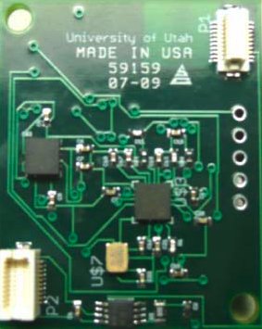
Previous Team
Review – Summary
Semi-completed Parts
  Microprocessor / LEDS
  Accelerometer

Slide 3
Planning
Last year
  Manufactured an untested board
    Increased debug time
    Ruined the boards
Where to start
  Build prototype boards
    Easier to modify, test, and debug
    Less delay when making final board

Slide 4
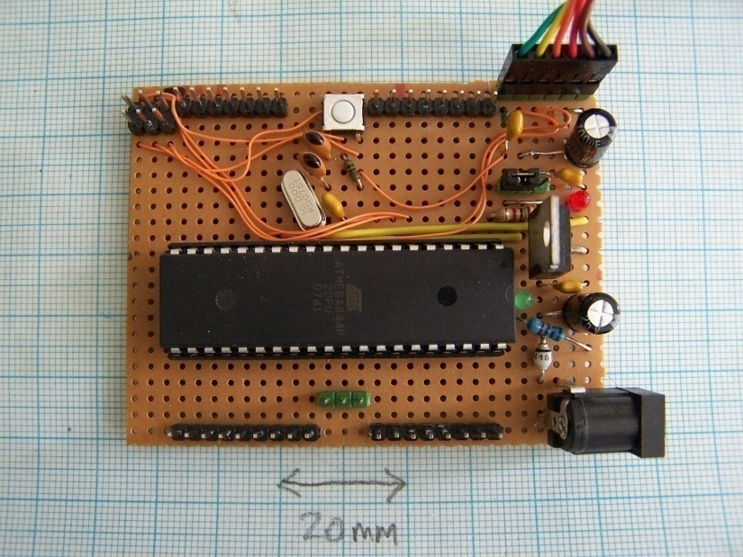
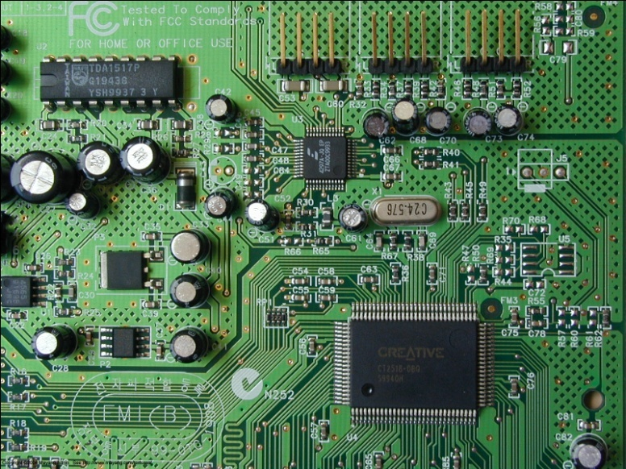
Prototypes
Prototypes will allow our team to easily:
  Trace problems
  Remove and replace failed components
  Expand functionality

Slide 5
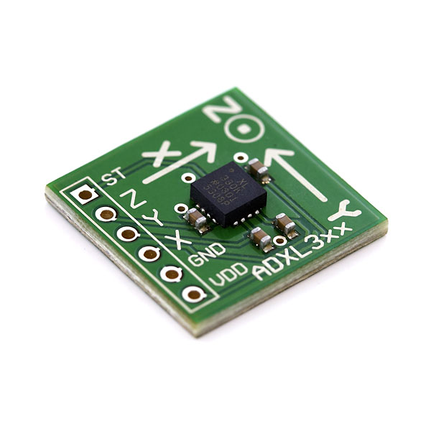
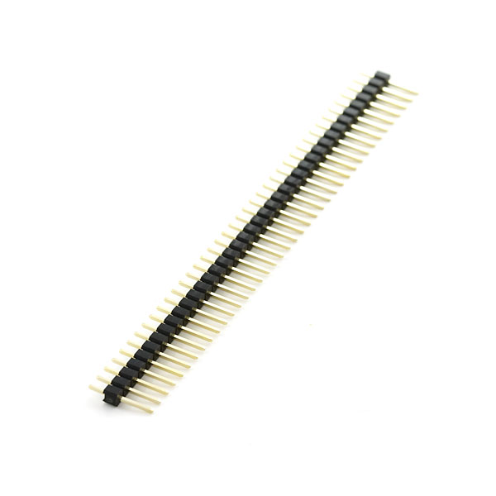
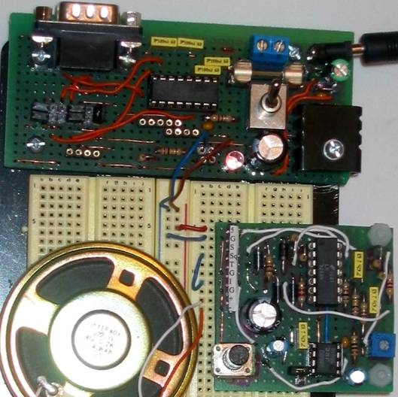
Prototype Construction
CAD
  Schematics
  Layout
Production
  Stripboard
  Pinheaders
  Breakout boards

Slide 6
Processing GPS Signals
Geotate
  Fast and only requires short signal.
  Unwilling to share the algorithm.
Matlab
  Needs all data.
  Takes a little longer to calculate the data.

Slide 7
Problem
  We are unable to use Geotate’s algorithms to process the small amount of data we will be retrieving.

Slide 8
Our solution
Develop software to search through the NASA database of satellite information and retrieve needed data using the data we have, and then run it through Matlab.
Or change the Matlab code so that we can use a smaller amount of data.

Slide 9
The Board
Power issues
  Using interrupts to wake the processor
Output to PC
  Using a button
  Through software
Using real time clock

Slide 10
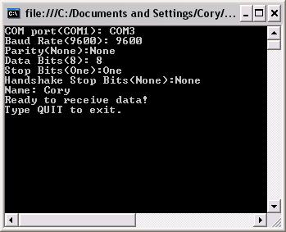
User Interface
Listen to COM port
Synchronize protocol
Output raw data into file
Processing and output
  Use Matlab
  (or our own program)
  Google Earth

Slide 11
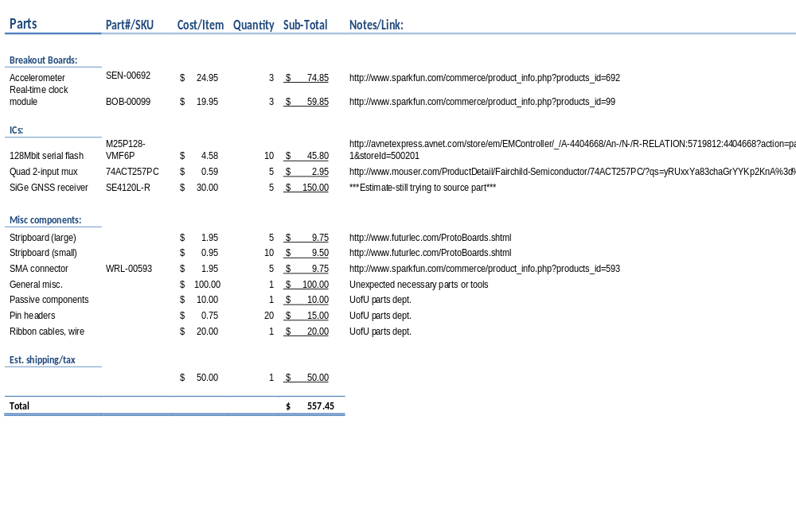
Prototype Budget

Slide 12
Time Frame
Priorities for functionality
  Storing on Flash memory from SiGe
    Time stamps, GPS data
  Low power
  Sending data to PC
  Processing and displaying data

Slide 13
Time Frame
Task | Projected time frame | Team Member(s)
Hardware/Prototypes
Order/build parts | 29 September – 17 October | Kerry
Testing
Existing board | 29 September – 17 October | Kerry/Cory
Prototypes | 15 October – 31 October | Kerry/Cory
Software
Flash/Mux | 30 September – 31 October | Hartman/Jake
SiGe | 26 October – 21 November | Hartman/Jake
Accelerometer | 19 October – 31 October | Hartman/Jake
Processor | 30 September - 31 October | Eidy
Raw GPS data processing | 26 October – 21 November | Hartman
GUI | 31 October – 30 November | Cory

